Slide 1

Yehudit Brickner 328601018 David Ehevich 212757405 Gilad Livshitz 206768962

Slide 2

System design
Project purpose
Teach me is an app that will help connect tutors and students.
How often do you see someone write in a WhatsApp group or Facebook group that they are looking for a tutor …
Our app can solve this problem by having one place where you can look for tutors and sign up for meetings to get help
The problem and solutions that exist
When looking for tutors online the first sites that come up are https://www.kanlomdim.co.il/ (כאן לומדים) https://www.limudnaim.co.il/ (לימוד נעים) which have lessons for kids in grades 1-12, or have few subjects that are meant for university students
When looking for apps, there are apps meant to help children and tutorial apps, but there aren’t any apps that are meant for university students
With all this said this app isn’t only for university students, but it could be a very useful tool for them

Slide 3
System design
Who is this app for?
Any student that needs help understanding the material taught in class or needs help with assignments, but is meant more for university students
Any person that wants to learn something new on a one-on-one bases
People who can give tutoring lessons
How does our app help solve the problem?
Our app can start here at this university and spread from it to help students all over

Slide 4
System design
About the app:
The app has 2 permissions tutor and student
Tutors create a lesson that contains meetings. The lesson has information that is relevant to the lessons The meetings have information that is relevant to this specific meeting, ex. date time
Students can search for lessons by name and date Then they will get Meeting Info about the lesson They then can sign up for the meetings
Both the tutor and the student can see their past and future meetings. They also can update their information and add the other permission if they don’t have such that someone could be a student and a tutor at the same time

Slide 5
System design
System requirements
Functional requirements
Tutor – create a Lesson and Meetings
Tutor – add a meeting summary
Student – search for a lesson
Student – sign up for a lessons meeting
Non-Functional requirements
Make the app easy to use (Usability)
Connection with other apps (WhatsApp)

Slide 6
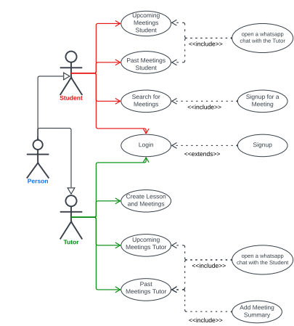
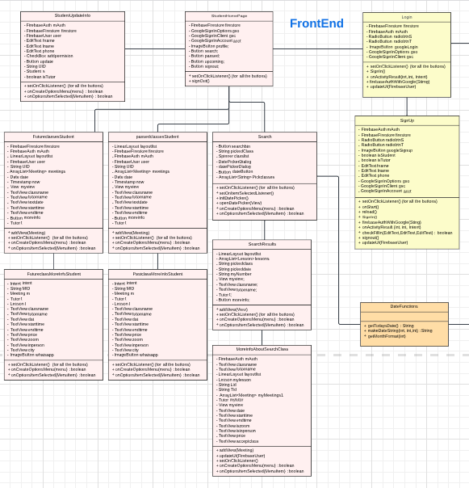
Graphs and Diagrams
Use case diagram
Part of the UML

Slide 7
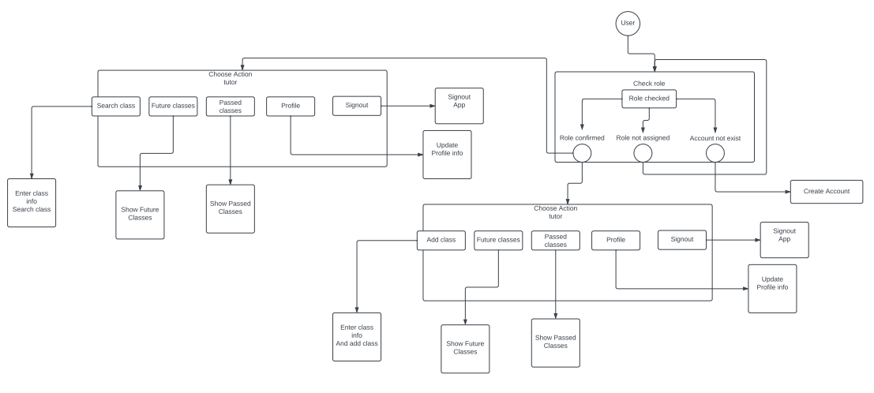
Graphs and Diagrams
State machine diagram

Slide 8
Technological mapping
System design
We use the MVC design – Model View Controller
Model
The model calls the functions that call the database
View
The view is the XMLs and the Activity classes
Controller
The controller connects the Model and View
If the view needs to show data from the database, it will call the controller who will call the model

Slide 9
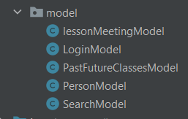
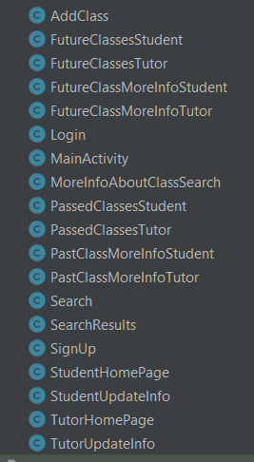
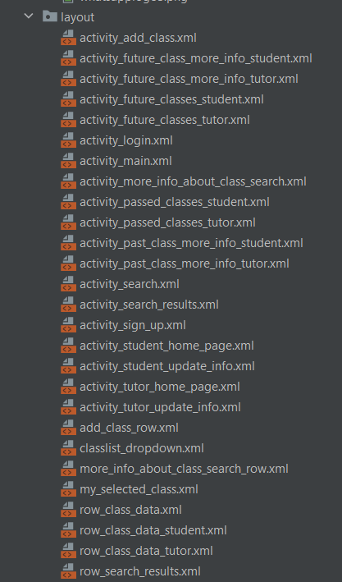
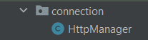
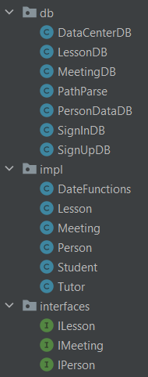
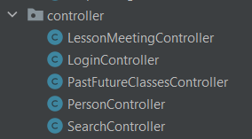
SERVER
CONTROLLER
VIEW
MODEL

Slide 10
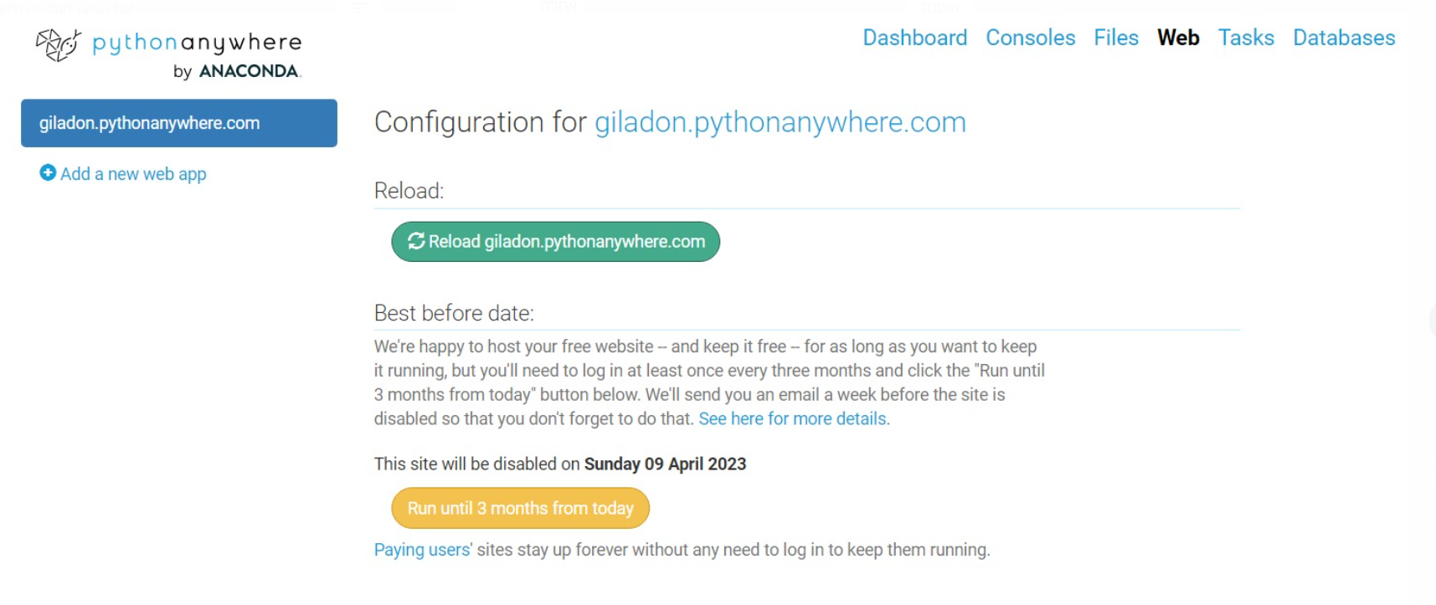
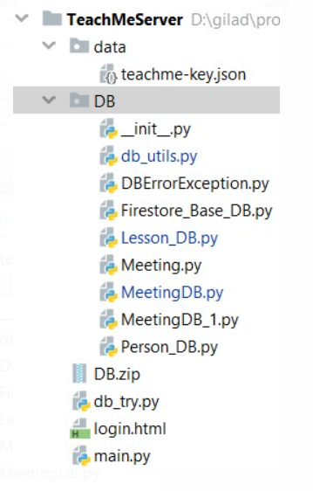
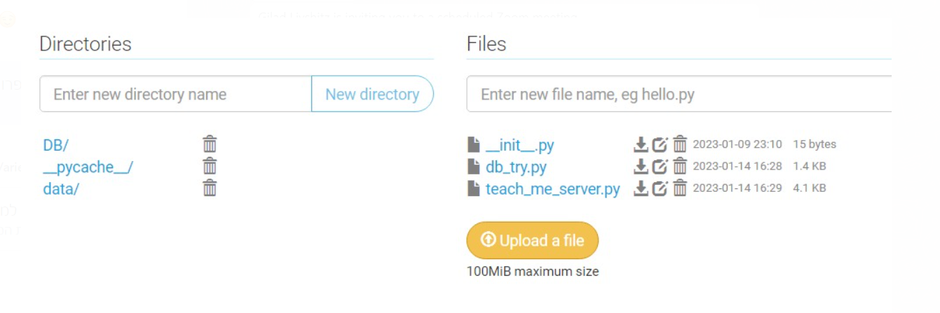

Slide 11


Slide 12
Disparities
We wanted to connect the app to WhatsApp and couldn’t get it to work
Are app allows you to be signed up to more than one meeting at a time

Slide 13
GitHub links
https://github.com/Yehudit-Brickner/TeachMe

